Slide 1
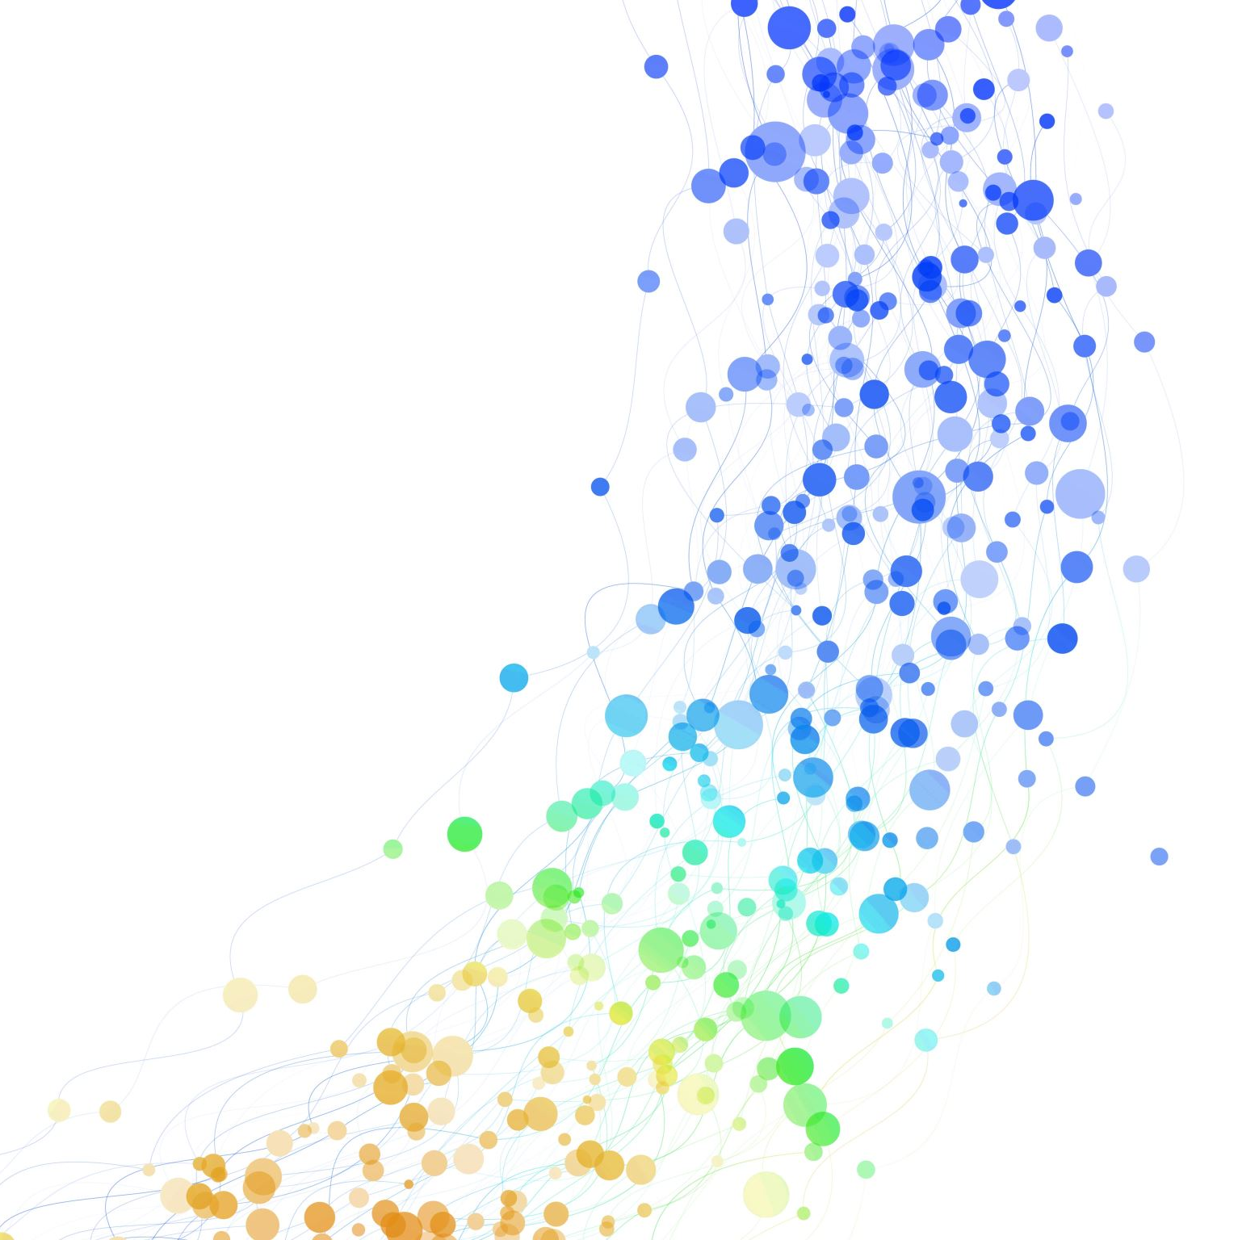
Connect-4
An autonomous robot player

Slide 2
Introductions
Fontys Supervisor
ALTEN Technical Supervisor
ALTEN Business Manager

Slide 3

About ALTEN
ALTEN is an international Technology and IT consultancy and Engineering company. Originally ALTEN was created in 1988 in France and currently they span over thirty countries, having established themselves in all the major sectors: Aeronautics & Space, Defence & Naval, Security, Automotive, Rail, Energy, Life Sciences, Finance, Retail, Telecommunications and Services.

Slide 4
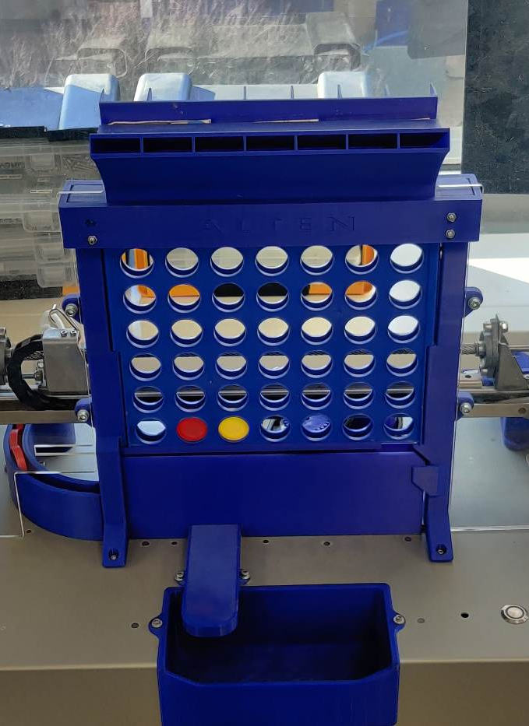
The Connect-4 Robot
The 4-in-a-row (Connect4, Four Up) robot was developed for demos at trade fairs and open days at universities.
The gameplay is autonomous. The robot can move in the X and Z planes, clean the board, separate the pieces. It also knows in which positions the tokens are placed and can decide where it should play next.

Slide 5
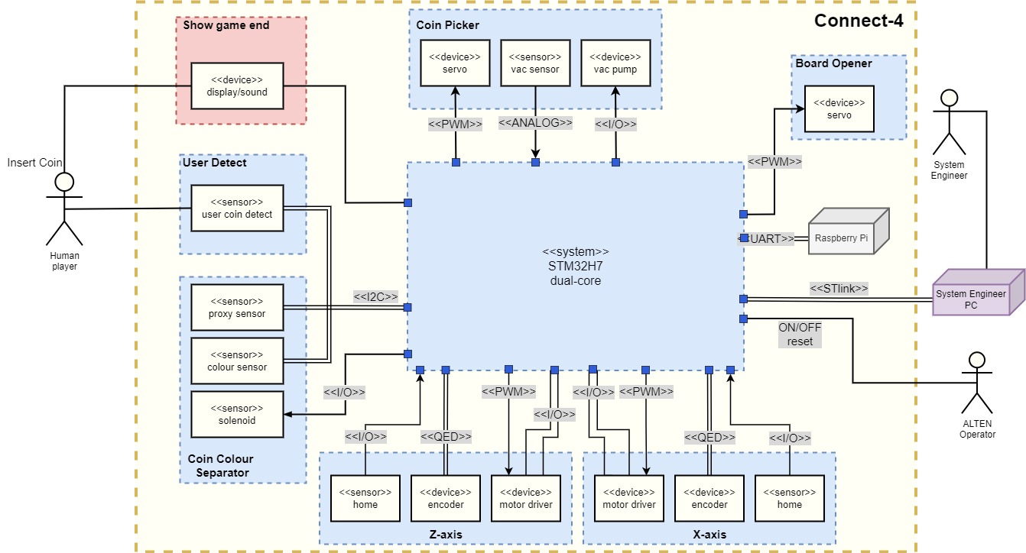
1. Designed software modules from the architecture design.
2. Tested modules on the Connect4 robot.
3. Research on ethernet communication for the system.

